Slide 1




Inchicore

Slide 2


Inchicore ☺
There are lovely flower gardens in our school. There are lots of playgrounds, parks and creches. A Luas runs through Inchicore.

Slide 3
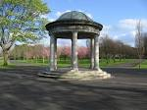

Inchicore ☺
Inchicore is a very popular place and so are our public parks in Dublin. There are pubs and shops down in Inchicore.

Slide 4

Inchicore ☺ !!!!☺
Inchicore is a lovely place to live in. There are hotels and pubs and lots more things in Inchicore. There is also a football team called Saint Patrick’s.

Slide 5
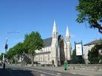
Inchicore ☺
Inchicore is a big open space there is everything in it. We have lovely flower gardens in our school. We also have a big church in our school

Slide 6
our school☺☺☺☺
BEST SCHOOL EVER!!!!!!!!!

Slide 7

Our School
Our school’s name is Scoil Mhuire gan Smal. There are around fourteen classes in our school and 313 students. Paul is very generous by giving us toast and a drink every morning. We have trips every year, Me and Chloe`s favourite trip is the trip to the Wicklow Mountains. It`s so cool. We have two green flags. This is a picture of our green flag.
→-→-→-→-→

Slide 8
OUR SCHOOL ☺
We have a Basketball hall, a Grotto, a field, a church, two breaks at 10:45 and 12:30, and a lot of more stuff. The school was built in 1939.It was actually a boy school, now it’s a mixed school. Our principal’s name is Ms. O Mahony, she is very nice. The church is right across the school, this school has a lot of subjects and a lot more fun stuff.

Slide 9
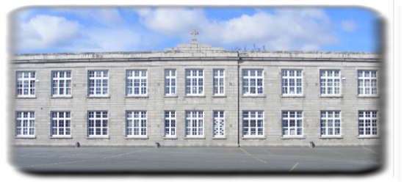
we love our school !!!!!!☺☺☺☺

Slide 10
Our school hall
The school hall is a place where the children do drama exercise and other stuff. The hall is used for assemblies.

Slide 11




S.M.G.S BASKETBALL HALL
The basketball hall is huge. There are four basketball nets, Well there is only two on court and two off court. Our school loves the basketball hall because we have professional basketball trainers who teach us how to play basketball. When we are in sixth class we get to play against the teachers in the basketball hall on sports day.
.

Slide 12

When we are in sixth class we get to play the teachers in the basketball hall on sports day.

Slide 13



Other schools come to the basketball hall to play matches against us.

Slide 14


We also have P.E. in the basketball hall

Slide 15
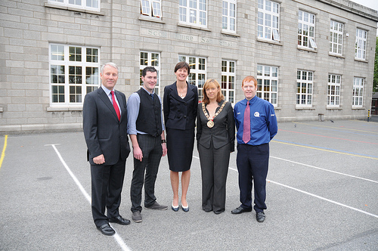
Our school yard
The yard is our playground. We play football and chat. We are not allowed to play chasing on the yard. We have two breaks, one from 10:45am to 11:00am and the other one from 12:30pm to 1 o’clock.

Slide 16
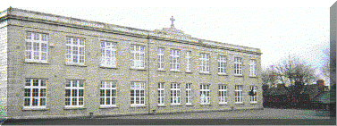
We have gates surrounding our yard so that the babies don’t escape. We don’t go out to the yard when it is raining. Today in our yard there is a construction site

Slide 17
They are building two offices and a new classroom. There is no parking in our school yard during school hours

Slide 18
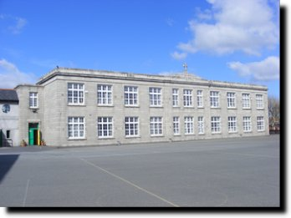
Sometimes there is rubbish on the yard and Paul Carey has to clean it up, “Poor Paul.”
Our yard is our fun place and we love playing in our yard everyday

Slide 19
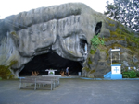
THE CHURCH
We go to bless ourselves in the church .It is very big .On top of the church it is shaped like a cross .

Slide 20

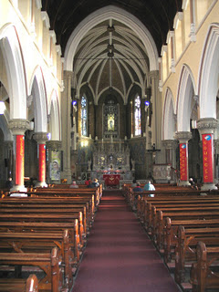
THE CHURCH
On our school uniforms there is the church with smgs on it. There is a statue of Mary when you walk inside the church .Beside the church there is a school called Scoil Mhuire Gan Smal .

Slide 21
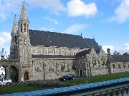
THE CHURCH
There is multi coloured glass in the church and you can get mass said for funerals,
Weddings , conformations ,communions and christenings .The church was built in 1878.

Slide 22
The Church
There is a story called The crucifixion when you walk around the church .When it is night time the church lights up and if you go there at night time it is lovely .

Slide 23

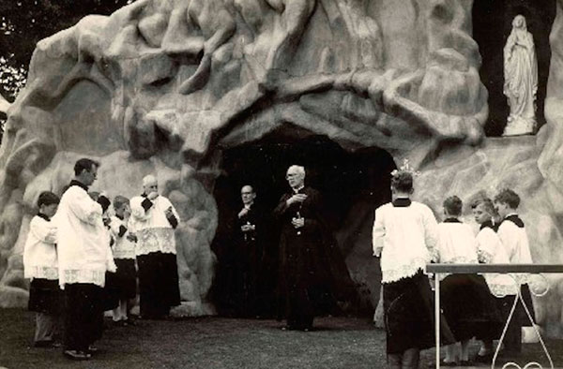
The Grotto !

Slide 24

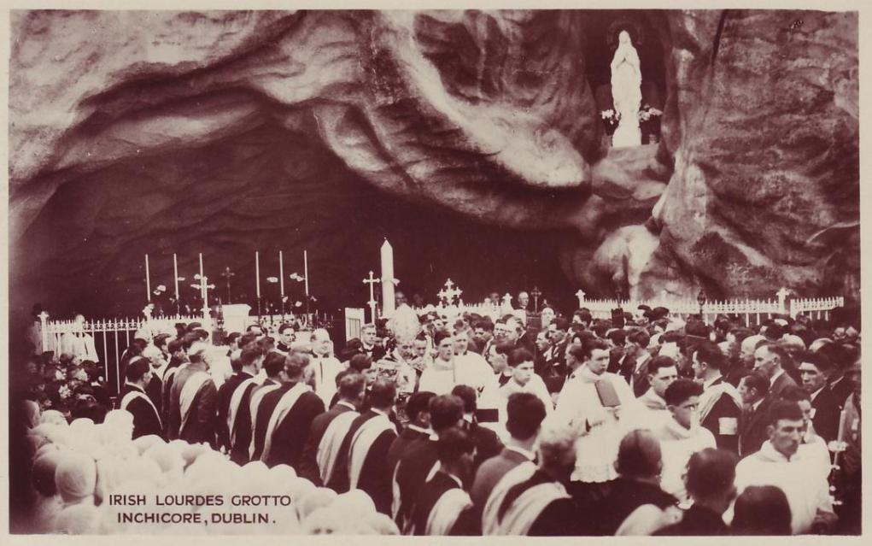
The grotto!
The Grotto has a statue of Mary on it. She is wearing lovely blue and white clothes.

Slide 25

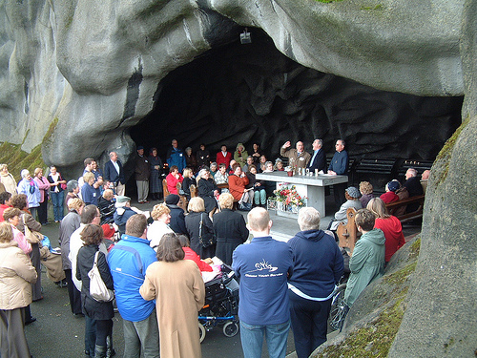
The grotto is 50 feet high and 130 feet wide and 40 feet deep. The crib opens at Christmas time.

Slide 26
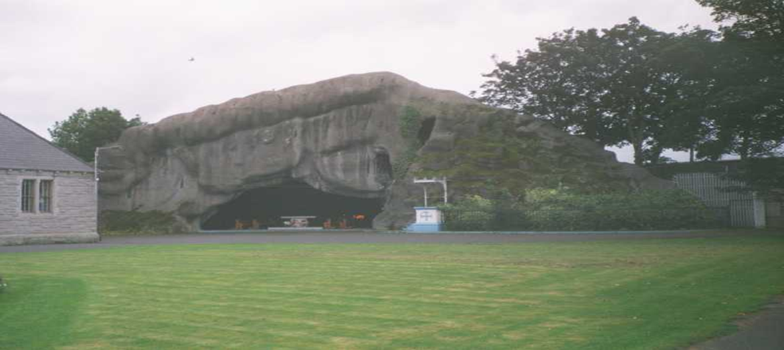
THE GROTTO

Slide 27
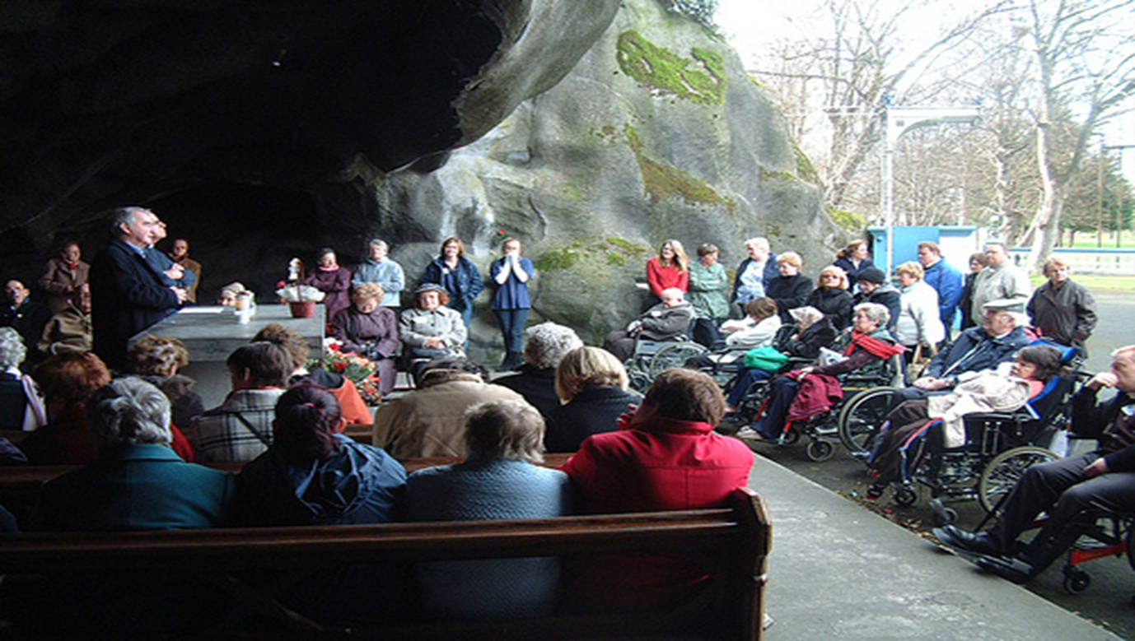
It is a lovely place to be.
People can light candles and pray for people who are sick or in heaven.

Slide 28
The field
Scoil mhuire gan smal

Slide 29
The field
The
field is a private ground but its ok to bring your dog on a
walk .the school
also does lots of activities over there for
example Sports
day cross country and Santry
try
-
outs
.
There
is even a graveyard for priests and it’s a lovely
walk around;you can smell the lovely flowers.
Field was
built in the late 1930’s.Before this
field was built, it was
a farm yard and an
arch made of rocks
there’s
only half
of
it left .My mam when I was a baby brought me over to
the field for
walks It’s
so lovely and fresh.

Slide 30
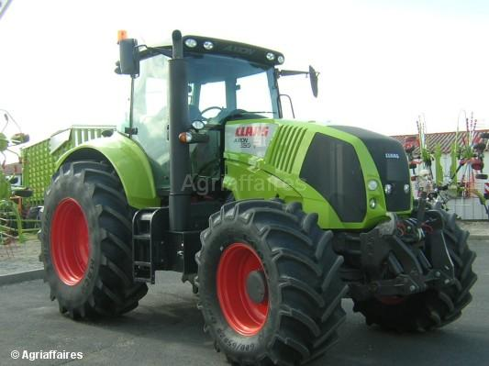
The field
There is lots of grass in the field so the priest have to cut it with a tractor and big mower.And they clean the leaves up from the trees.

Slide 31
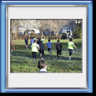
WE LOVE OUR FIELD

Slide 32
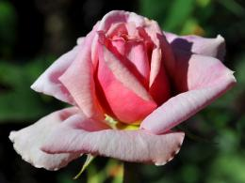
The flowers
There are different types of flowers in our school.
Most of the flowers are roses.
Our school is mostly covered in nature, because every year it seems like plants flowers and trees are growing and our school gets greener by recycling and picking up our litter.
It is also important to collect rubbish because it keeps our gardens and fields clean and also to keep our beautiful flowers and plants growing.

Slide 33
Canal of Inchicore
The Grand Canal was built between 1756 and 1803 and links Dublin, the Capital City to the Shannon, Ireland's longest River.

Slide 34
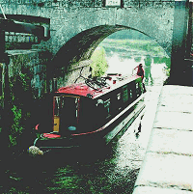
The Grand Canal starts
at the Shannon,
and goes through Tullamore,
Edenderry, Sallins and
Lucan before Inchicore

Slide 35
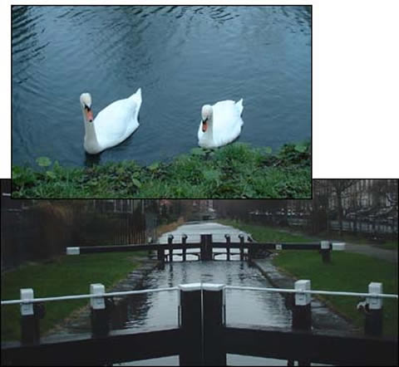

It took about 1000 to 10000 men to build the canal.

Slide 36
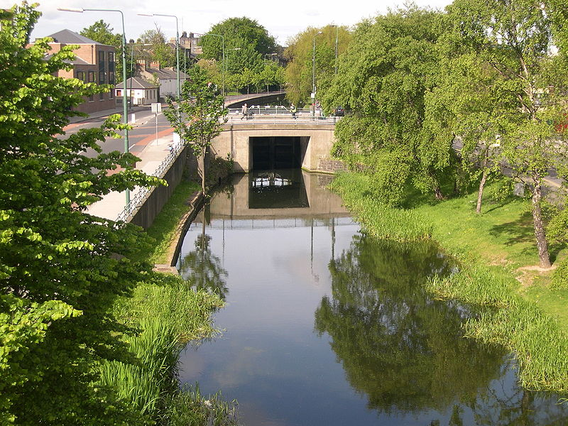
By 1768, about 77,000 euro had been spent on the project and little more was coming.

Slide 37
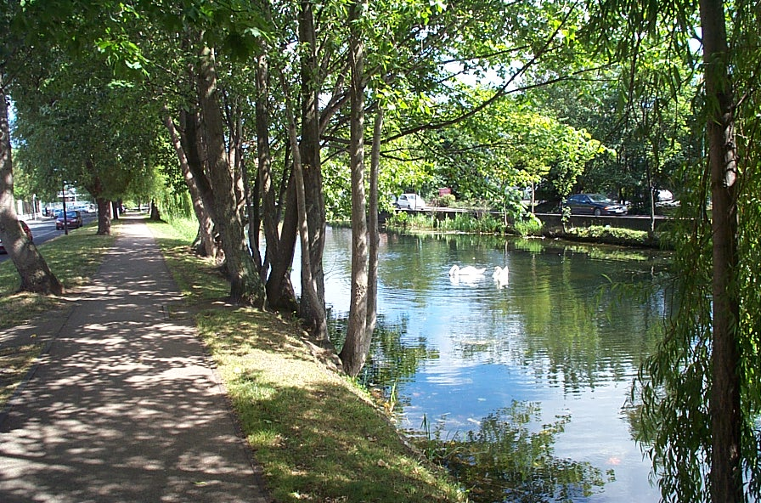
The whole work cost around 877,000 euro altogether.
It is nice to go for a walk beside the canal.

